Slide 1

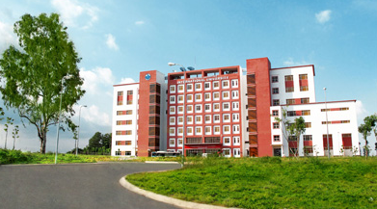
International University
MICRO-PROCESSING SYSTEM
Lecture 1_B:
AVR C language to Assembly Language Compiler Tutorial 1
Vo Minh Thanh, M.Eng
School Of Electrical Engineering

Slide 2
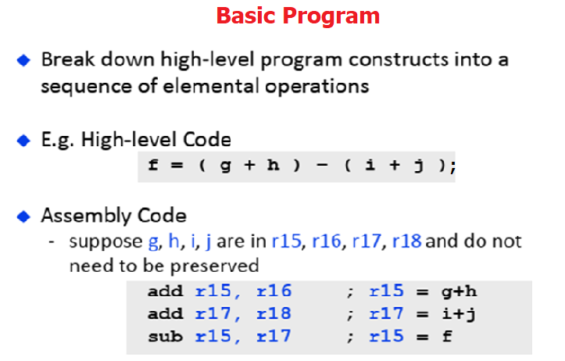

Slide 3
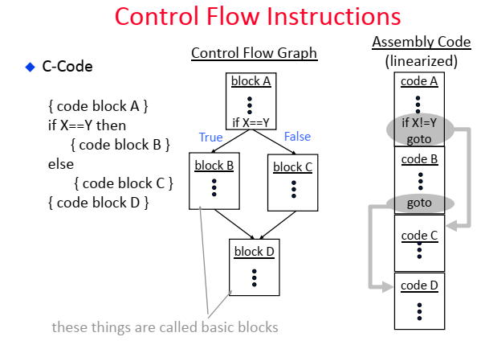

Slide 4
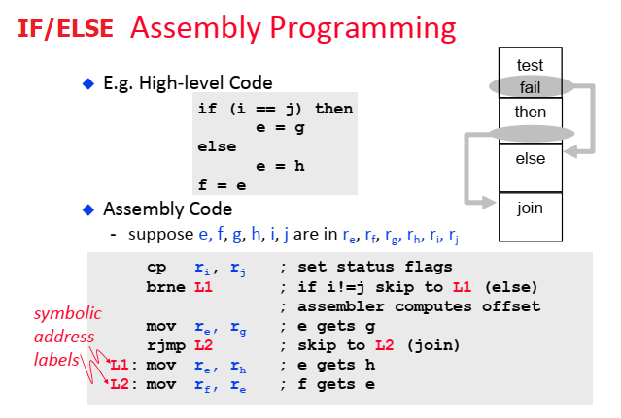

Slide 5
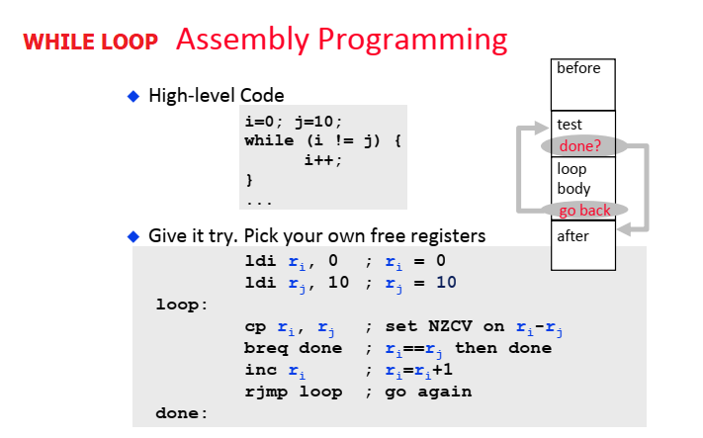

Slide 6
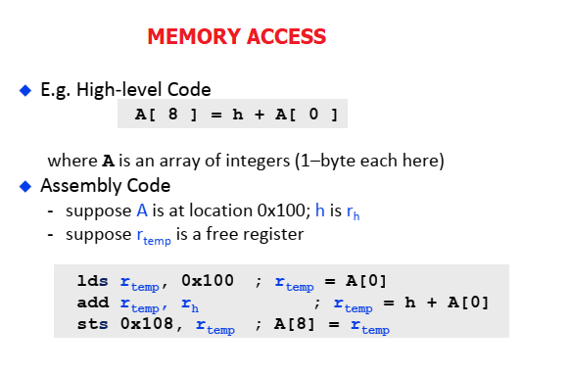

Slide 7
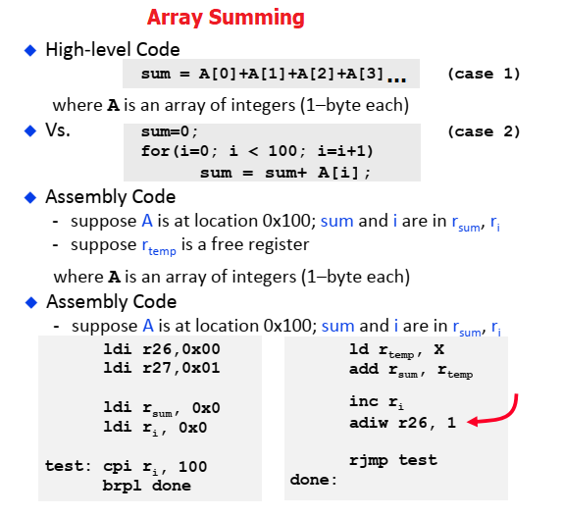

Slide 8
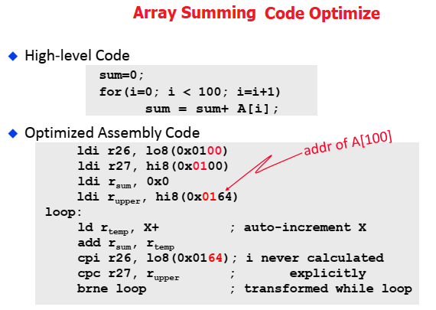

Slide 9
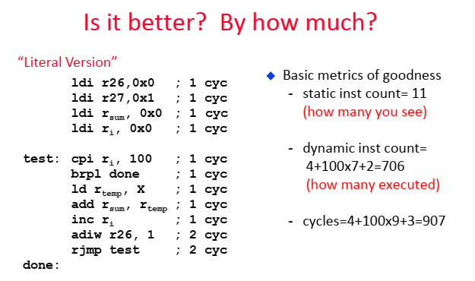

Slide 10
